Slide 1
AD analysis enhancement
Curve Trending Detection
Peng Tan / Siqi Zhou

Slide 2
Agenda
Motivation
Proposed solutions
Comparison (before vs after)
Testing result

Slide 3
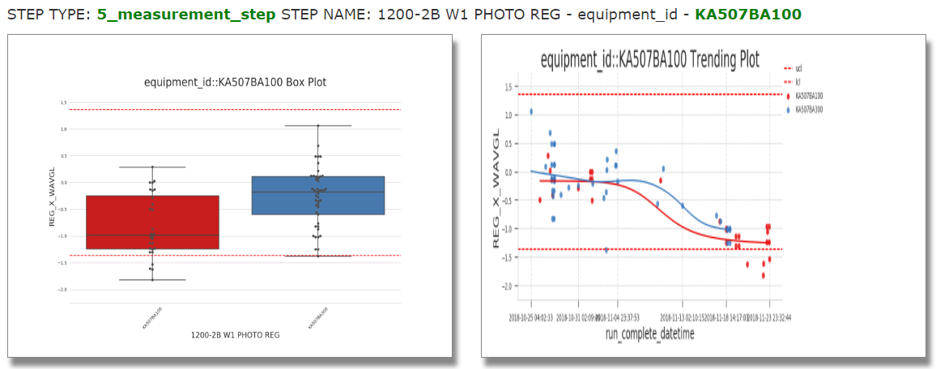
Motivation
PEE gave us a feedback that most highlighted toggles are obviously wrong when looking at time trend in one AD report.

Slide 4
Proposed solutions
T-test
ARIMA
Linear regression in Scikit-learn

Slide 5
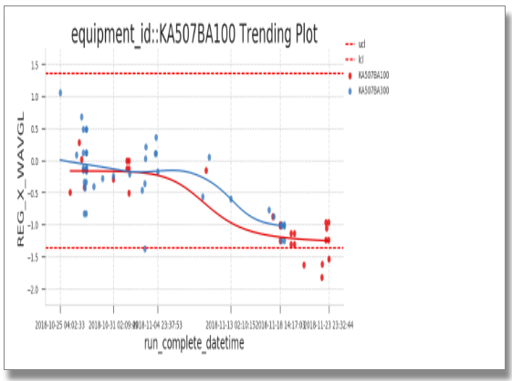
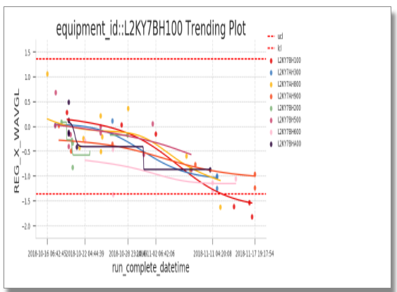
1. t-test
T-test is able to filter the left case. However, it doesn’t work for the right case.
T-test only describes the variance of two different datasets (p-value) which is not enough for us to determine the curve trending and it is not sensitive in terms of time series analysis.

Slide 6
2. ARIMA
ARIMA will catch too detailed trend information.
ARIMA is good at time series forecasting in python however training data for prediction is useless for our case.
Long running time concern since we need to auto tune the parameter (p, d, q)
auto.arima() is not able to be applied in python directly
Need to judge aic/bic values to find the best (p, d, q)

Slide 7
3. Linear regression in scikit-learn
Separate as two datasets, root cause and non root cause
Criteria: slope sign, slope difference and the percentage of OOC points

Slide 8
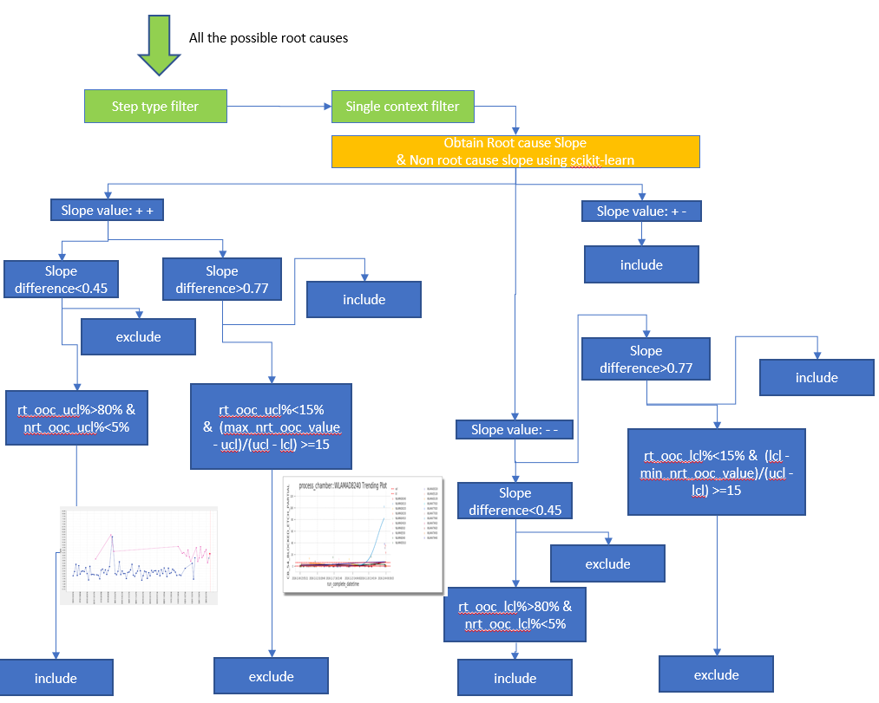
3. Linear regression in scikit-learn

Slide 9
3. Linear regression in scikit-learn
Why Step type filter?
In order to make sure this new feature won’t filter out the correct found cases leading to decreasing accuracy.
Currently many correct cases from users’ feedback are from FMEA/process step.
Why Single context filter/special handling for potential root causes with a single context?
This feature needs to keep the same judgement as a new feature that we released recently for filtering the single context value in AD report.
A special handling to make the code more robust: Single context filter is used for the case that non root cause datasets have less than 2 points meaning no slope.

Slide 10
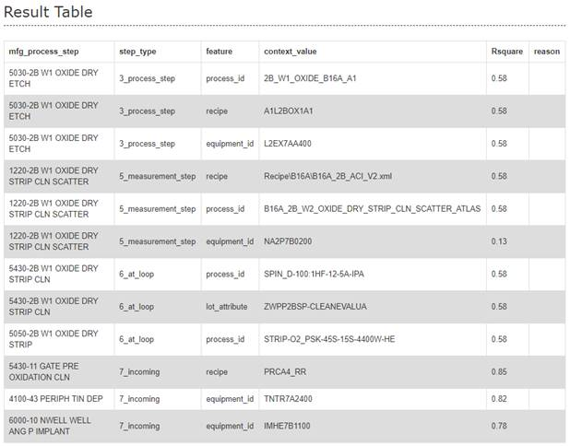
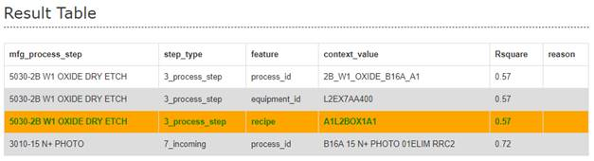
Comparison 1- Result table
Before
After
AD repot link
AD repot link

Slide 11
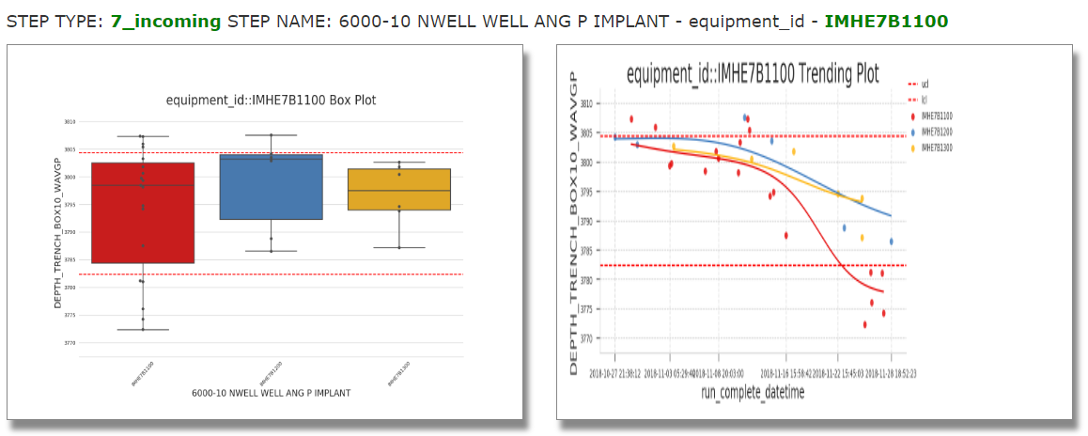
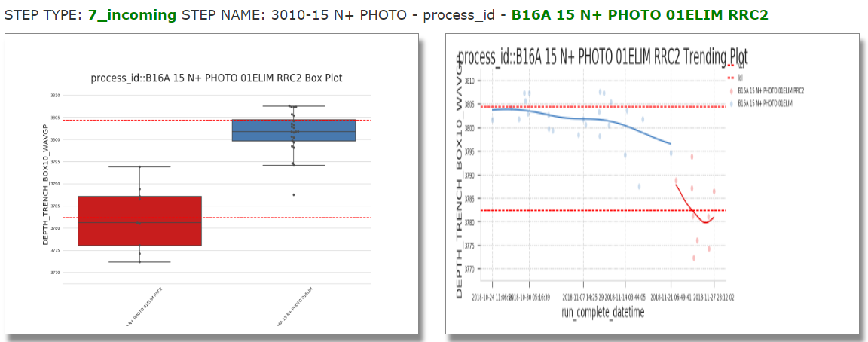
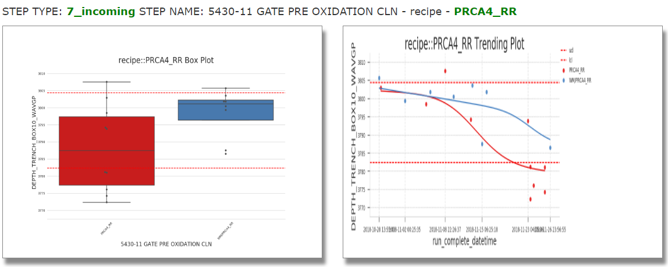
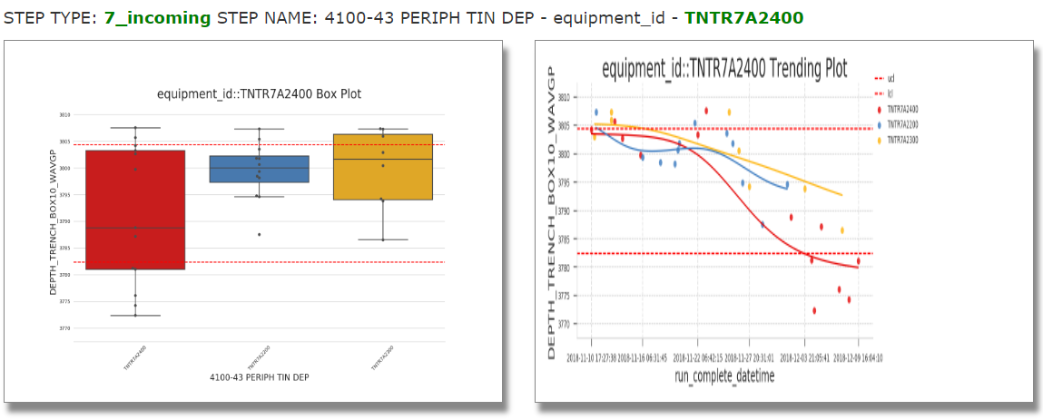
Comparison 1- plotting
Before
After

Slide 12
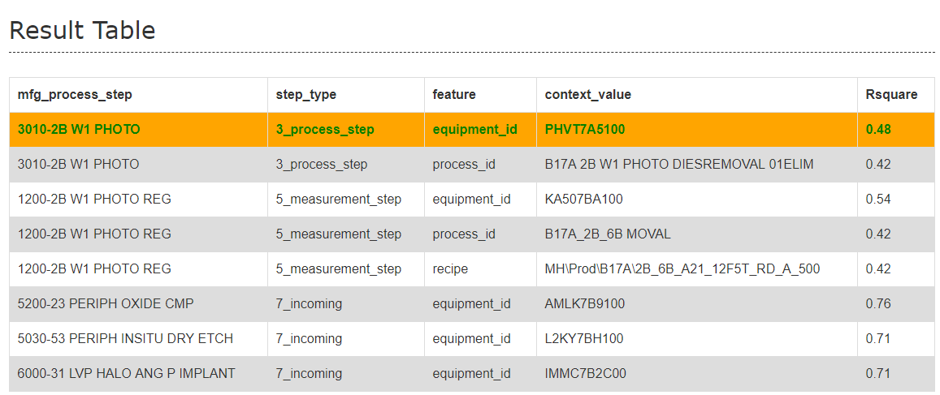
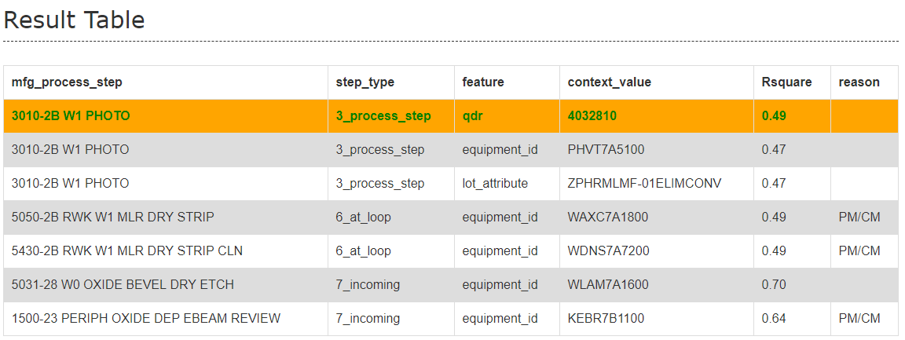
Comparison 2 - Result table
Before
After
AD repot link
AD repot link

Slide 13

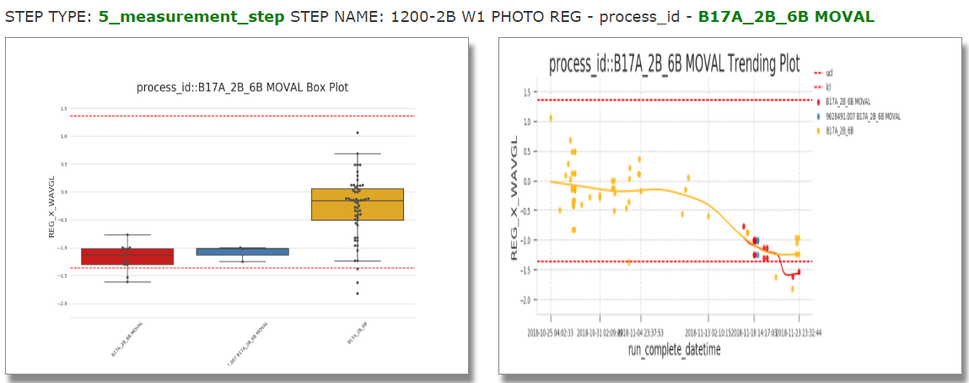
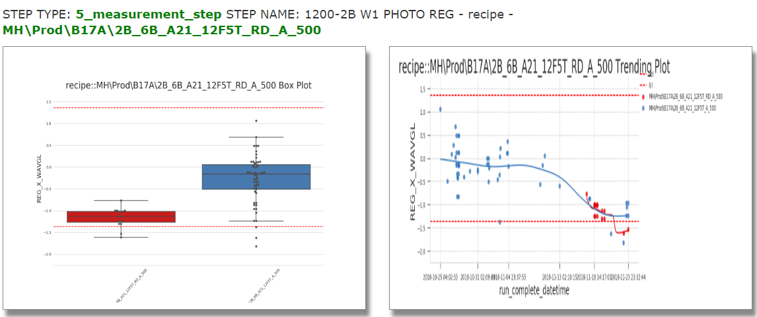
Comparison 2 - plotting
5_measurement_step
Before
After
No highlight from 5_measurement_step

Slide 14
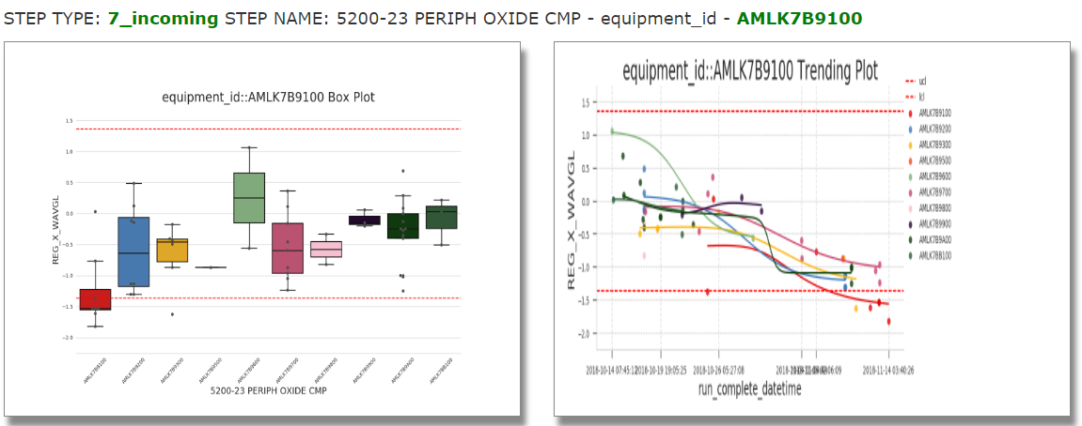
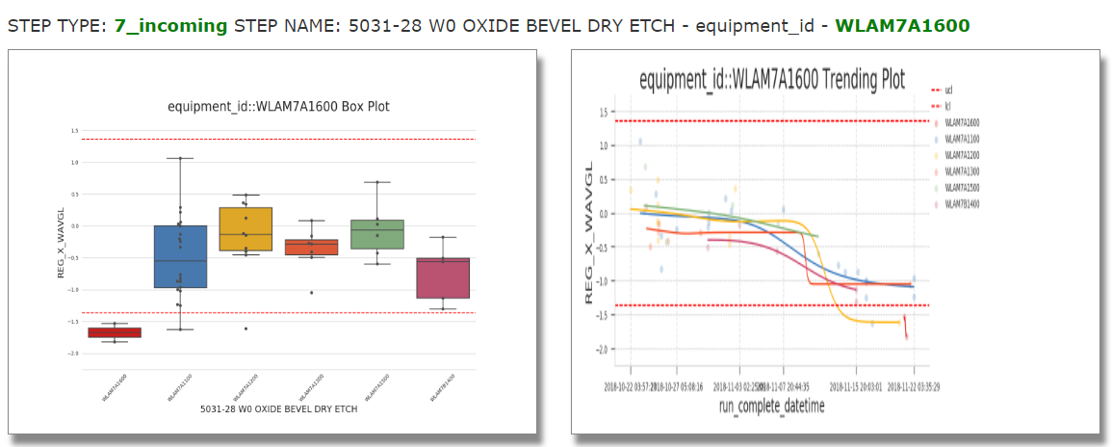
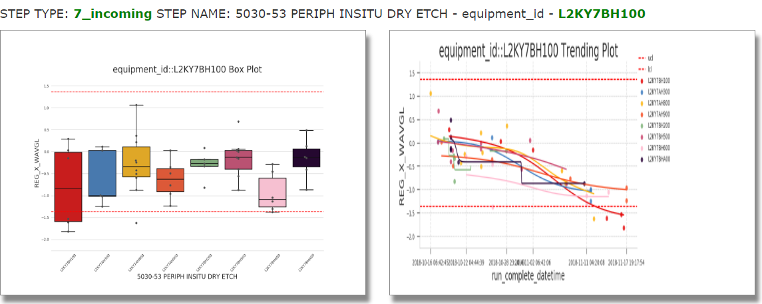
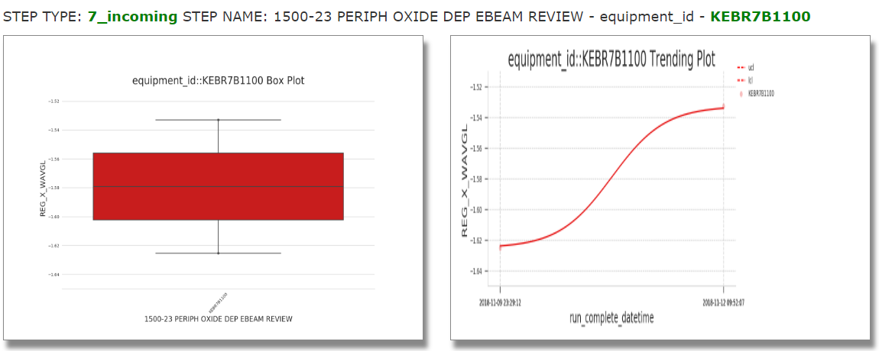
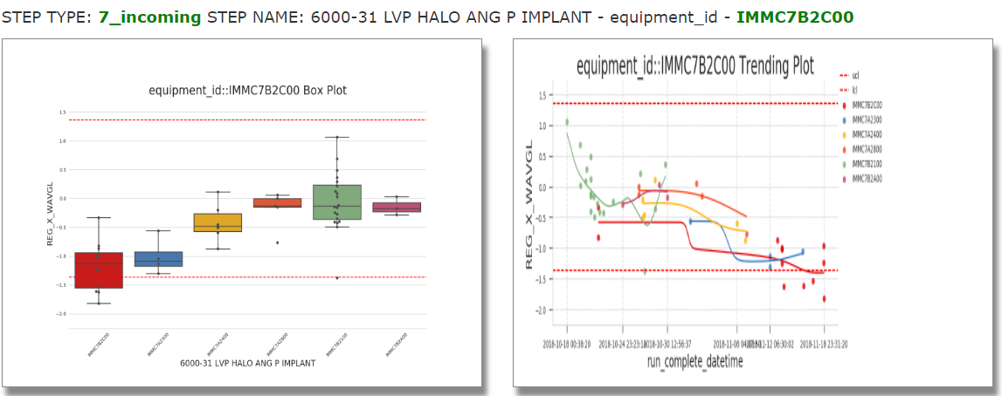
Comparison 2 - plotting
7_incoming
Before
After

Slide 15
Testing Result - Root cause found
 | Link | Context value | Slope difference | Slope sign | Before applying trending algorithm whether Root cause can be found | After applying trending algorithm whether Root cause can be found
1 | http://fslhdppds01/rda_ad/2018-12-10/10_589505_0_Mean_2018121017.html | TAVGABHP30 | 0.6045579496002268 | ++ | y | y
2 | http://fslhdppds01/rda_ad/2018-12-11/10_640635_0_Mean_2018121117.html | TEVXAN1930 | 2.6909841482376367 | +- | y | y
3 | http://fslhdppds01/rda_ad/2018-12-11/10_657053_0_Mean_2018121117.html | EB3SAY76B0 | 1.13417668512788 | +- | y | y
4 | http://fslhdppds01/rda_ad/2018-12-11/10_657595_0_Mean_2018121117.html | AOAMABJPC0 | 1.0899721133004472 | +- | y | y
5 | http://fslhdppds01/rda_ad/2018-12-12/10_640623_0_Mean_2018121217.html | L2KYAE3210 | 0.7953314189056716 | -- | y | y
6 | http://fslhdppds01/chronic_ad/2018-12-13/10_583369_4_EWMA-Mean_2018121300.html | TEVXATEE00 | 0.21926461724098065 | ++ | y | y
7 | http://fslhdppds01/chronic_ad/2018-12-10/10_674528_46_Mean_2018121000.html | 55_BL_OXIDE_B17A_M3_LTN | single context value |  | y | y
8 | http://fslhdppds01/chronic_ad/2018-12-14/10_632481_5_EWMA-Mean_2018121400.html | AMRPAPAH00 | non_root_cause only has one point |  | y | y
9 | http://fslhdppds01/chronic_ad/2018-12-10/10_695639_3_Mean_2018121000.html | TELFADAQ00 | single context value |  | y | y
10 | http://fslhdppds01/chronic_ad/2018-12-17/10_675684_3_Sigma_2018121700.html | N18A_55SIF_H_04 | single context value |  | y | y

Slide 16
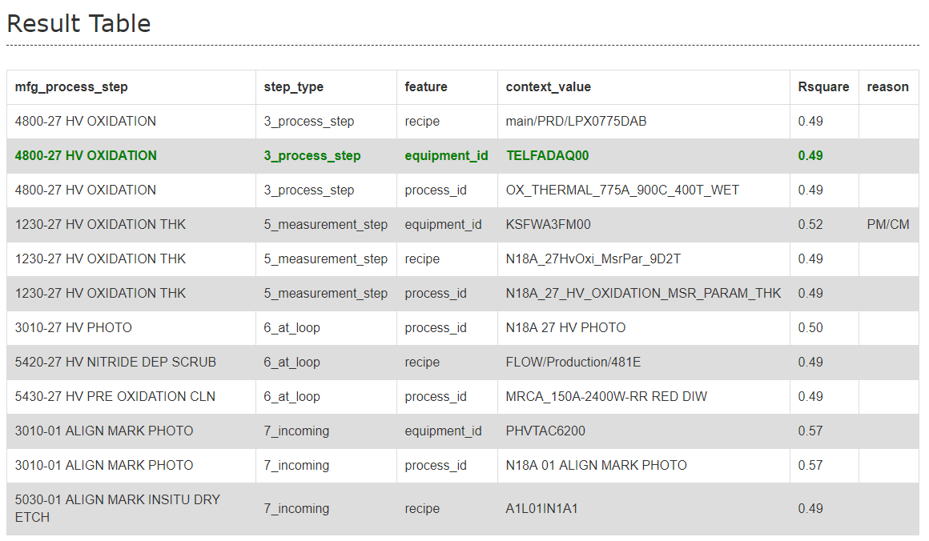
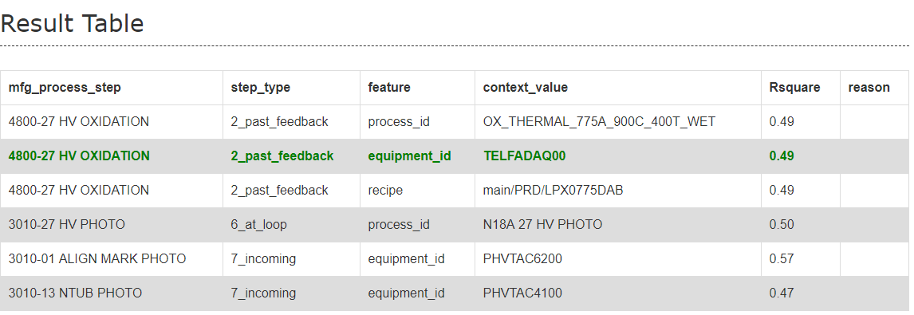
Testing Result - Root cause found
Before
After

Slide 17
Testing Result - Root cause not found
 | Link | Context value | Slope difference | Slope sign | Before applying trending algorithm whether Root cause can be found | After applying trending algorithm whether Root cause can be found
1 | http://fslhdppds01/chronic_ad/2018-12-11/10_731832_33_Sigma_2018121100.html | PHVTAC4200 | 0.2930229876227967 | ++ | n | n
2 | http://fslhdppds01/chronic_ad/2018-12-14/7_234100_49_Mean_2018121400.html | TEVX7AT400 |  |  | n | n
3 | http://fslhdppds01/chronic_ad/2018-12-11/7_234106_16_EWMA-Mean_2018121100.html | L2EX7AA410 |  |  | n | n
4 | http://fslhdppds01/chronic_ad/2018-12-12/7_278327_3_Mean_2018121200.html | WDNS7B6200 |  |  | n | n
Even though it still cannot find the correct root cause, the result table provided by AD will show less rows after applying this feature, leading to more confidence especially for potential root causes from step_type ‘incoming’.

Slide 18
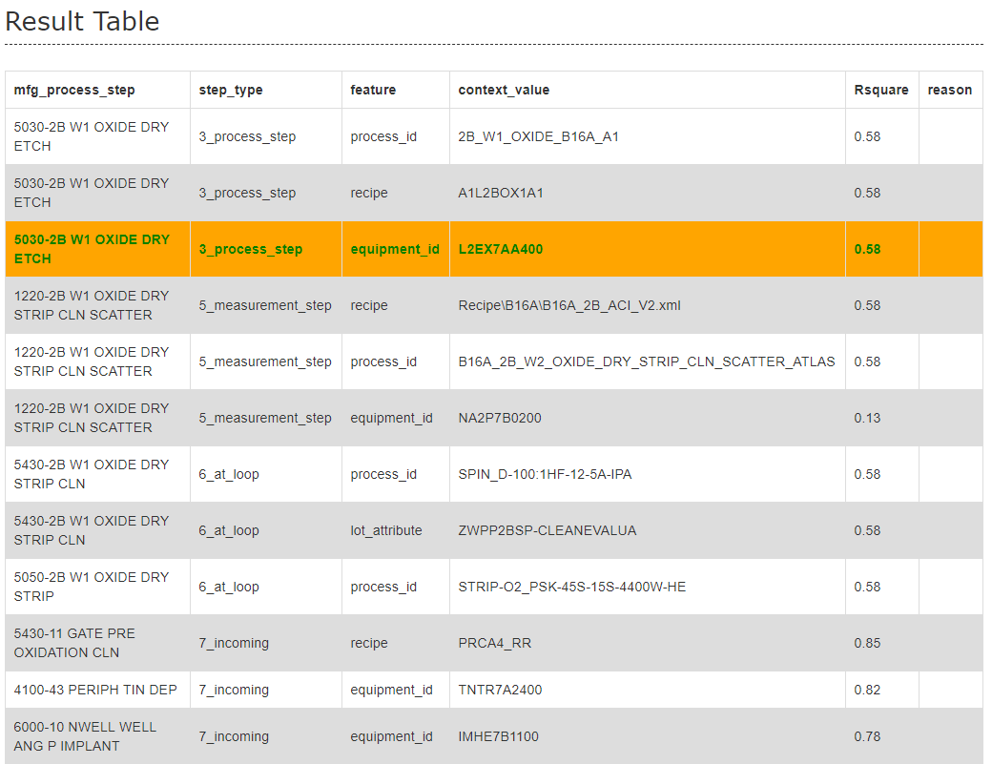
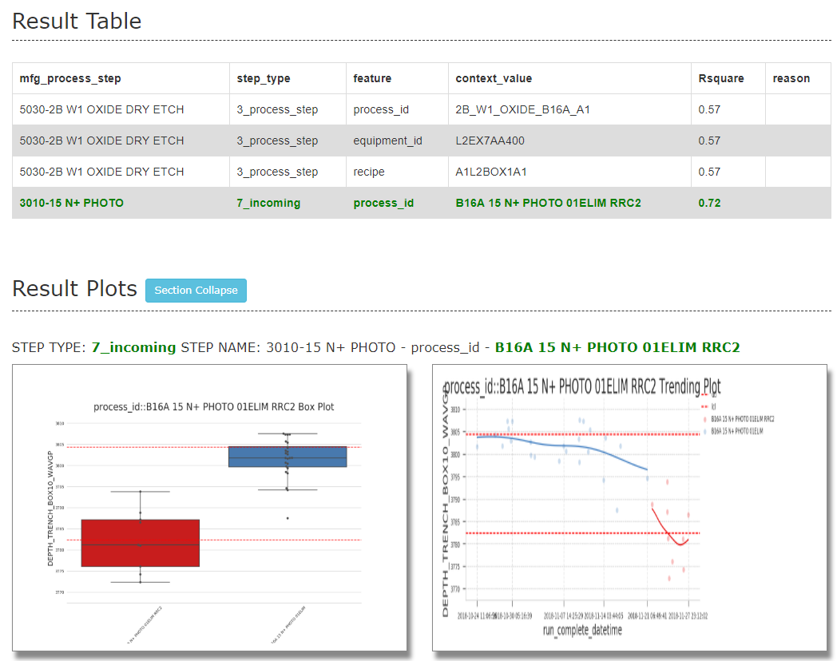
Testing Result - Root cause not found
Before
After

